Slide 1
Recovering the 3D shape of an object from 2D images
By Rishitha Bandi(015237521)

Slide 2
Introduction
Natural images are projection of 3D object on a 2D image plane.
The knowledge gained from the 2D images is used to recover the 3D shape of the object. The methodologies of recovering 3D shape varies with the source of 2D images.

Slide 3
Existing Methods of GANs
Generative adversarial networks can model the 2D natural image manifold of diverse object categories with high fidelity.
The phenomenon of GAN changing viewpoint of object in generated images motivates the possibility of reconstructing the 3D shape from single 2D image
However, due to either heavy memory consumption or increased difficulty in training, there are still gaps between their image qualities and those of 2D GANs.
In unsupervised learning of 3D shapes, it doesn’t need manual annotations and lacks multiple viewpoints and lightning instances. To tackle it they adopted the shapes from the external 3D shapes or 2D images which learns viewpoint and shape via autoencoders that explicitly model the rendering process.

Slide 4
Methodologies for Recovering 3D Shape
The methodology of using GAN to learn 3D shapes from images which rely on explicitly modelling 3D representation and rendering during training.
Another methodology of learning 3D shapes from the images learns the viewpoint and shapes of images in ‘analysis by synthesis’ manner.

Slide 5
Proposed model
On the image generated by GAN an ellipsoid is employed and as its first 3D object shape and render several unnatural images called pseudo samples.
Pseudo samples are randomly sampled viewpoints and lighting conditions.
By reconstructing pseudo samples using the GAN, those could guide the original image towards the sampled viewpoints and lighting conditions in the GAN manifold, producing a number of natural-looking images, called projected samples.

Slide 6
Continue..
We present the first attempt to reconstruct the 3D object shapes using GANs that are pre-trained on 2D images only. Our work shows that 2D GANs inherently capture rich 3D knowledge for different object categories and provides a new perspective for 3D shape generation.
Our work also provides an alternative unsupervised 3D shape learning method and does not rely on the symmetry assumption of object shapes.
We achieve highly photo-realistic 3D-aware image manipulations including rotation and relighting without using any external 3D models.

Slide 7
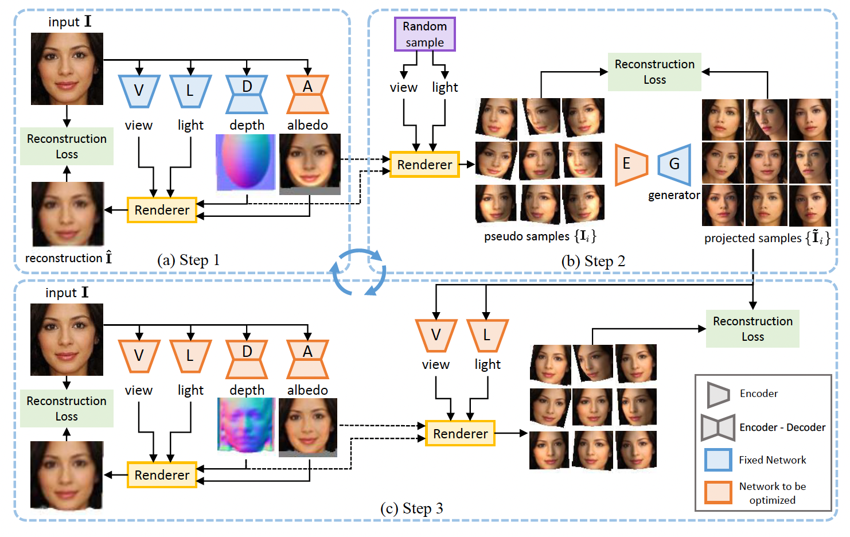

Slide 8
Step 1: Using a Weak Shape Prior
With single image instance to explore images with many viewpoints and lighting to the GAN image manifold could resort to ellipsoid as weak prior to create pseudo samples.
The viewpoint v and lighting l are initialized with a canonical setting, i.e., v0 = 0 and lighting is from the front.
This allows us to have an initial guess about the four factors d0(depth), a0(albedo), v0(viewpoint),l0(lighting), with d0 being the weak shape prior.

Slide 9
Step 2: Sampling and Projecting to the GAN Image Manifold.
Pseudo samples have unnatural distortions and shadows, they provide cues on how the face rotates and how the light changes.
In order to leverage such cues to guide novel viewpoint and lighting direction exploration in the GAN image manifold, we perform GAN inversion to these pseudo samples, i.e., reconstruct them with the GAN generator

Slide 10
Step 3: Learning the 3D Shape
The viewpoint network, lighting network , the depth network and albedo network are all together optimised to learn the 3D shape.
The reconstruction loss is minimised on when all the predictions are inferred.
The unnatural distortions and shadows that exist in the pseudo samples are mitigated in the reconstructions.

Slide 11
Conclusion
We have presented the first method that directly leverages off-the-shelf 2D GANs to recover 3D object shapes from images. We found that existing 2D GANs inherently capture sufficient knowledge to recover 3D shapes for many object categories, including human faces, cats, cars, and buildings. Based on a weak convex shape prior, our method could explore the viewpoint and lighting variations in the GAN image manifold, and exploit these variations to refine the underlying object shape in an iterative manner.

Slide 12
References
https://arxiv.org/pdf/2011.00844v4.pdf

Slide 13
THANK YOU!!

